Slide 1



CAPSTONE PROJECT Movie Rental Data Analysis Using SQL
Vaibhav Sirohi
NIIT Batch DA92S9

Slide 2



Objective of Presentation
The objective of the project is to use MySQL to analyze the data of a movie rental store for further growth and improved business.
Extracting meaningful insights of movie rental store using sakila database and By understanding various SQL query techniques and their application, we can gain valuable insights and make data-driven decisions for movie on rent chain.

Slide 3


Table of Content
Motion Pictures Data Analysis
Task1. Display the full names of actors available in the database
Task2. Management wants to know if there are any names of the actors appearing frequently.
Task3. The management is interested to analyze the similarity in the last names of the actors.
Task4. The management wants to analyze the movies based on their ratings to determine if they are suitable for kids or some parental assistance is required. Perform the following tasks to perform the required analysis.
Task5. The board members want to understand the replacement cost of a movie copy(disc — DVD/Blue Ray).The replacement cost refers to the amount charged to the customer if the movie disc is not returned or is returned in a damaged state.
Task6. Display the names of the top 3 movies with the greatest number of actors.
Task7. "Music of Queen’ and 'Kris Kristofferson’ have seen an unlikely resurgence.
Task8. The film ‘Agent Truman’ has been a great success. Display the names of all actors who appeared in this film.
Task9. Sales have been lagging among young families, so the management wants to promote family movies. Identify all the movies categorized as family films.
Task10 The management wants to observe the rental rates and rental frequencies(Number of time the movie disc is rented).
Task11. In how many film categories, the difference between the average film replacement cost((disc — DVD/Blue Ray) and the average film rental rate is greater than $15?
Task12. Display the film categories in which the number of movies is greater than 70.

Slide 4

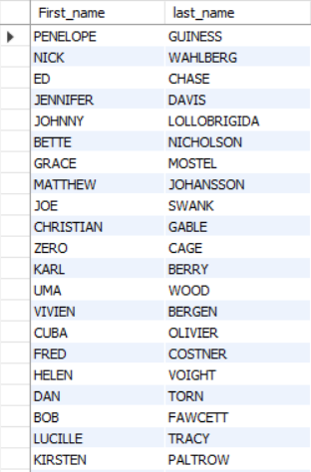
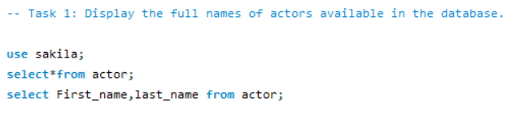
Task 1: Display the full names of actors available in the database
Query
Interpretation
Here, We selected the desired column from the actor table present and select first_name and last_name from actor and fetched the output.
Output Result

Slide 5
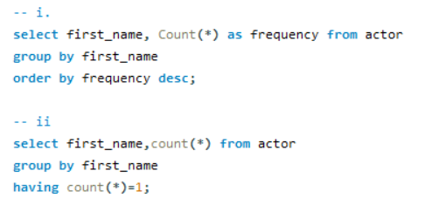
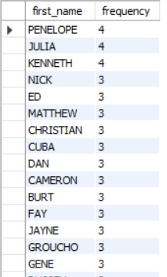
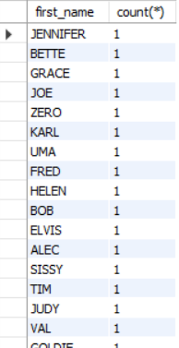
Task 2: Management wants to know if there are any names of the actors appearing frequently. -- i. Display the number of times each first name appears in the database. -- ii. What is the count of actors that have unique first names in the database? Display the first names of all these actors.
Query:
Interpretation
Here, we selected the desired column for all the sub task one by one by using Group by, count function for the respective tables from sakila database.
Output Result

Slide 6
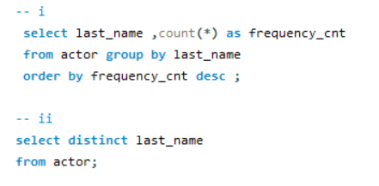
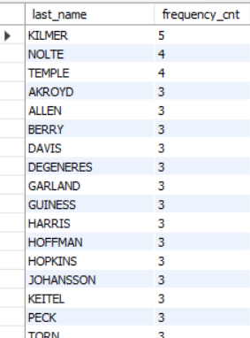
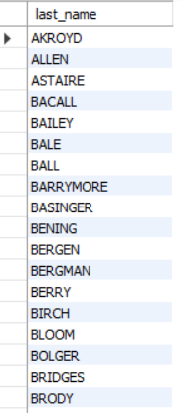
Task 3 : The management is interested to analyze the similarity in the last names of the actors.
Query:
Interpretation
In this task we selected the desired column from the actor table used count function ,group by, order by and distinct function to fetch the desired o/p.
Output Result

Slide 7
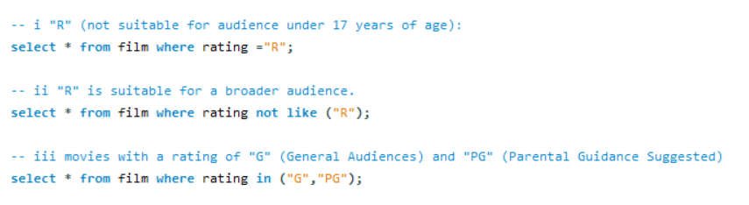

Task 4 -- Task 4: The management wants to analyze the movies based on their ratings to determine if they are suitable for kids or some parental assistance is required. Perform the following tasks to perform the required analysis.
Interpretation
Query:
In this task we selected the desired column from the FILM table group by rating using not like ,in function to fetch desired o/p.
Output Result

Slide 8
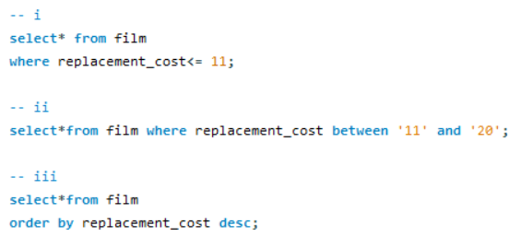
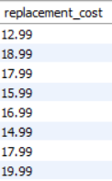
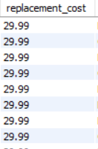

Task 5 : The board members want to understand the replacement cost of a movie copy(disc — DVD/BlueRay). -- The replacement cost refers to the amount charged to the customer if the movie disc is not returned or is returned in a damaged state. -- i. Display the list of records for the movies where the replacement cost is up to $11. -- ii. Display the list of records for the movies where the replacement cost is between $11 and $20. -- iii. Display the list of records for the all movies in descending order of their replacement costs.
Query:
Output Result
Interpretation:
In the above task the desired table for all the three task is same the FILM table.
So, for all the three task desired column is replacement_cost and by the help of function like between and some operator we fetched the desired output.

Slide 9
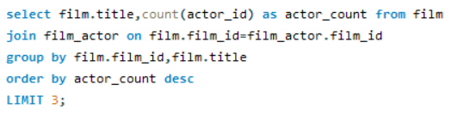
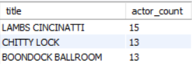
Task 6: Display the names of the top 3 movies with the greatest number of actors.
Query:
Output Result
Interpretation
Task 6 we have selected the desired column as f.film_id and f.title from table film_actor to fetch the desired output by apply where condition and limit function for top3.

Slide 10
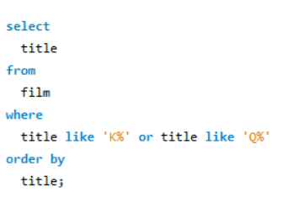
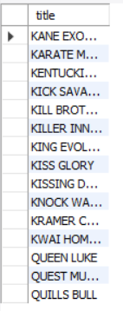
Task 7: "Music of Queen’ and 'Kris Kristofferson’ have seen an unlikely resurgence.-- As an unintended consequence, films starting with the letters "K" and "Q" have also soared in popularity.-- Display the titles of the movies starting with the letters 'K* and "Q".
Query:
Output Result
Interpretation:
Here, we selected the desired column from the table FILM and used the ‘where’ ‘like’ order by to sort and Arithmetic operator ‘%’ function to fetch the particular name that starts with K and Q alphabet.

Slide 11
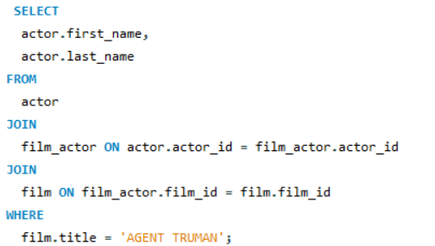
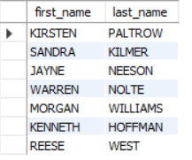
Task 8: The movie ‘AGENT TRUMAN' has been a great success. Display the first names and last names of all actors who are a part of this movie.
Query:
Output Result
Interpretation:
:
For task 8, we selected the desired column from the actor table by using joins we got all the matching records of all actors who are the part of movie ‘AGENT TRUMAN’ .

Slide 12
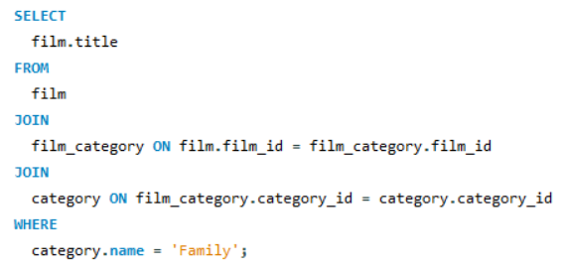
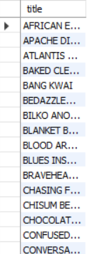
Task 9: Sales has been down among the family audience with kids The management wants to promote the movies that fall under the children' category. Identify and display the names of the movies in the family category.
Query:
Interpretation:
:
Here, we selected the desired column from the table film, as list of film titles that belong to the children ' category. We have use Join to connect the film, film_category, and category tables based on their respective IDs to fetch the desired result.
Output Result

Slide 13
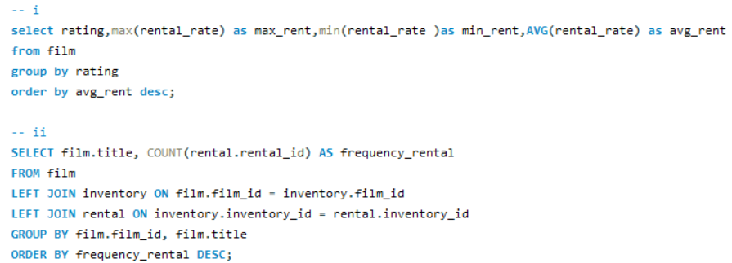
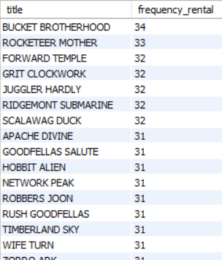
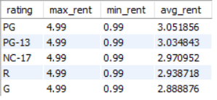
Task 10: The management wants to observe the rental rates and rental frequencies(Number of time the movie disc is rented).-- i. Display the maximum, minimum, and average rental rates of movies based on their ratings. The output must be sorted in descending order of the average rental rates.-- ii. Display the movies in descending order of their rental frequencies, so the management can maintain more copies of those movies.
Query:
Output Result
Interpretation:
We selected the desired column from the film table as we have used COUNT,JOIN,GROUP BY ,ORDER BY, DESC function to fetch the desired output.

Slide 14
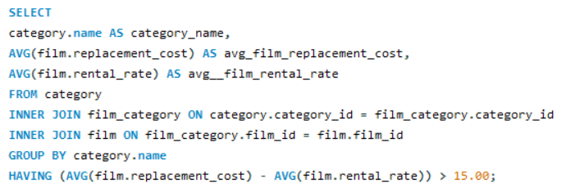
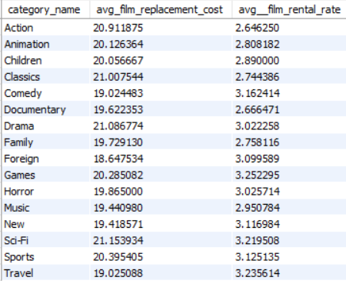
Task 11: Task 11: In how many film categories, the difference between the average film replacement cost((disc — DVD/Blue Ray) and the average film rental rate is greater than $15?– Display the list of all film categories identified above, along with the corresponding average film replacement cost and average film rental rate.
Query:
Interpretation
Here in this task, we selected the desired column name from the Table category. So, as of the task we have first count all the movie category from film table and by using JOIN and group By function fetched the desired output. only include movies where the average film rental rate is greater than $15?
Output Result

Slide 15
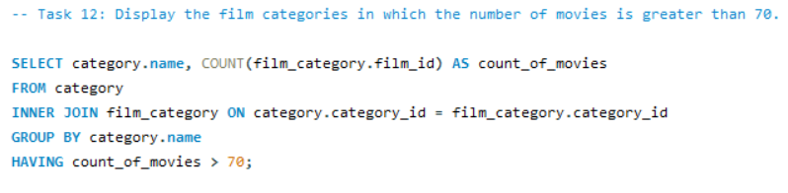

Task 12: Display the film categories in which the number of movies is greater than 70.
Query:
Output Result
Interpretation:
Here, we selected the desired column from the table category and joins the category and film_category tables based on the category ID and calculated the count of movies for each category using the COUNT function and filter the count of movies greater than 70.

Slide 16

Conclusion
Each task focuses on a specific aspect, such as filtering movies based on replacement cost, finding popular genres, or identifying movies with the highest rentals.
Top Rented Movie:
Movie Title: "Bucket Brotherhood"
Average Rental Price: $3.05
Frequency of Rental: 34 times
Top Movie Categories:
Top Category 1: Action with replacement cost $20.91 and Average Rental Rate: $2.64
Top Category 2: Animation with replacement cost $20.12 Average Rental Rate: $2.808
Movies Suitable for Children:
Number of G-rated Movies (General Category): 805
Number of PG-rated Movies (Parental Guidance): 372
Max Replacement Cost for a Movie:
The maximum allowable replacement cost for a movie is $29.99.
Top 3 Actors in Movies:
Top Actor 1: LAMBS CINCINNATI with Number of Movies: 15
Top Actor 2: CHITTY LOCK with Number of Movies: 13
Top Actor 3: BOONDOCK BALLROOM with Number of Movies: 13

Slide 17
THANK YOU
Reception robots.

